Slide 1
British Airways
Word Cloud Analysis on reviews collected from British Airways Customer Reviews - SKYTRAX (airlinequality.com) using web scrapping in Python.

Slide 2
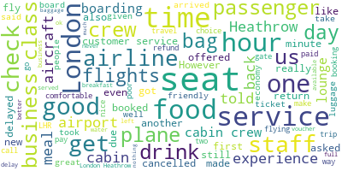
Word Cloud on customer Reviews
Conclusion:
Positive words: good, comfortable, well, better, great, service, friendly, offered, etc.
Negative words: delay, delayed, cancelled, poor, refund, never, etc.

